Slide 1
hw#2 과제 #3 P532 16번 문제
16조 이수영, 원준서

Slide 2
목차
03-04p Main.cpp 코드, 실행결과
05-06p Shape.h, Shape.cpp
07-08p Circle.h, Circle.cpp
09-10p Rect.h, Rect.cpp
11-12p Line.h, Line.cpp
13-14p UI.h, UI.cpp
15-18p GraphicEditor.h, GraphicEditor.cpp

Slide 3
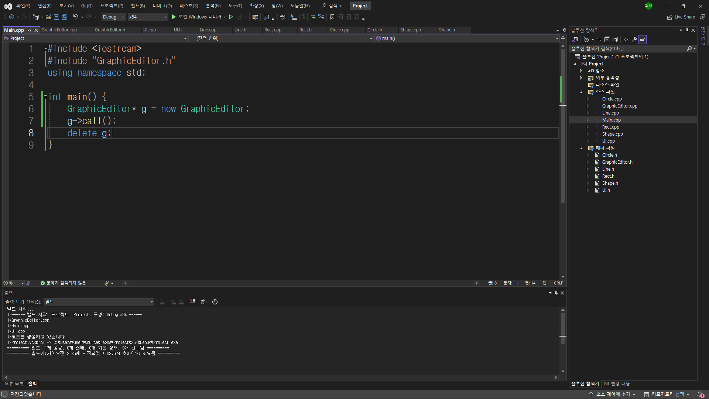
Main.cpp(1)코드

Slide 4
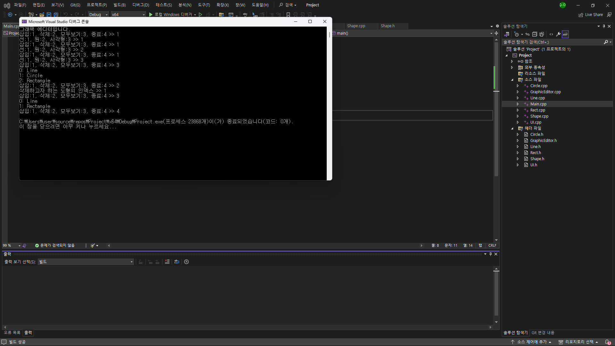
Main.cpp(2)실행결과

Slide 5
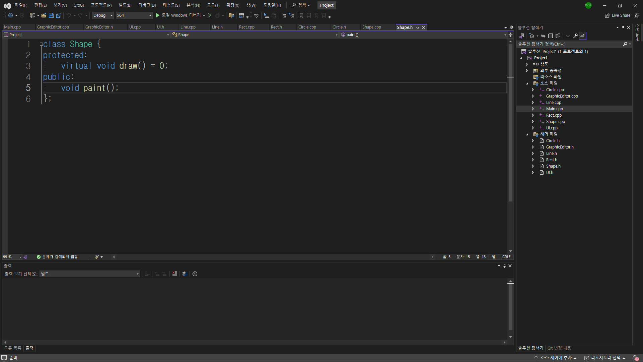
Shape.h

Slide 6
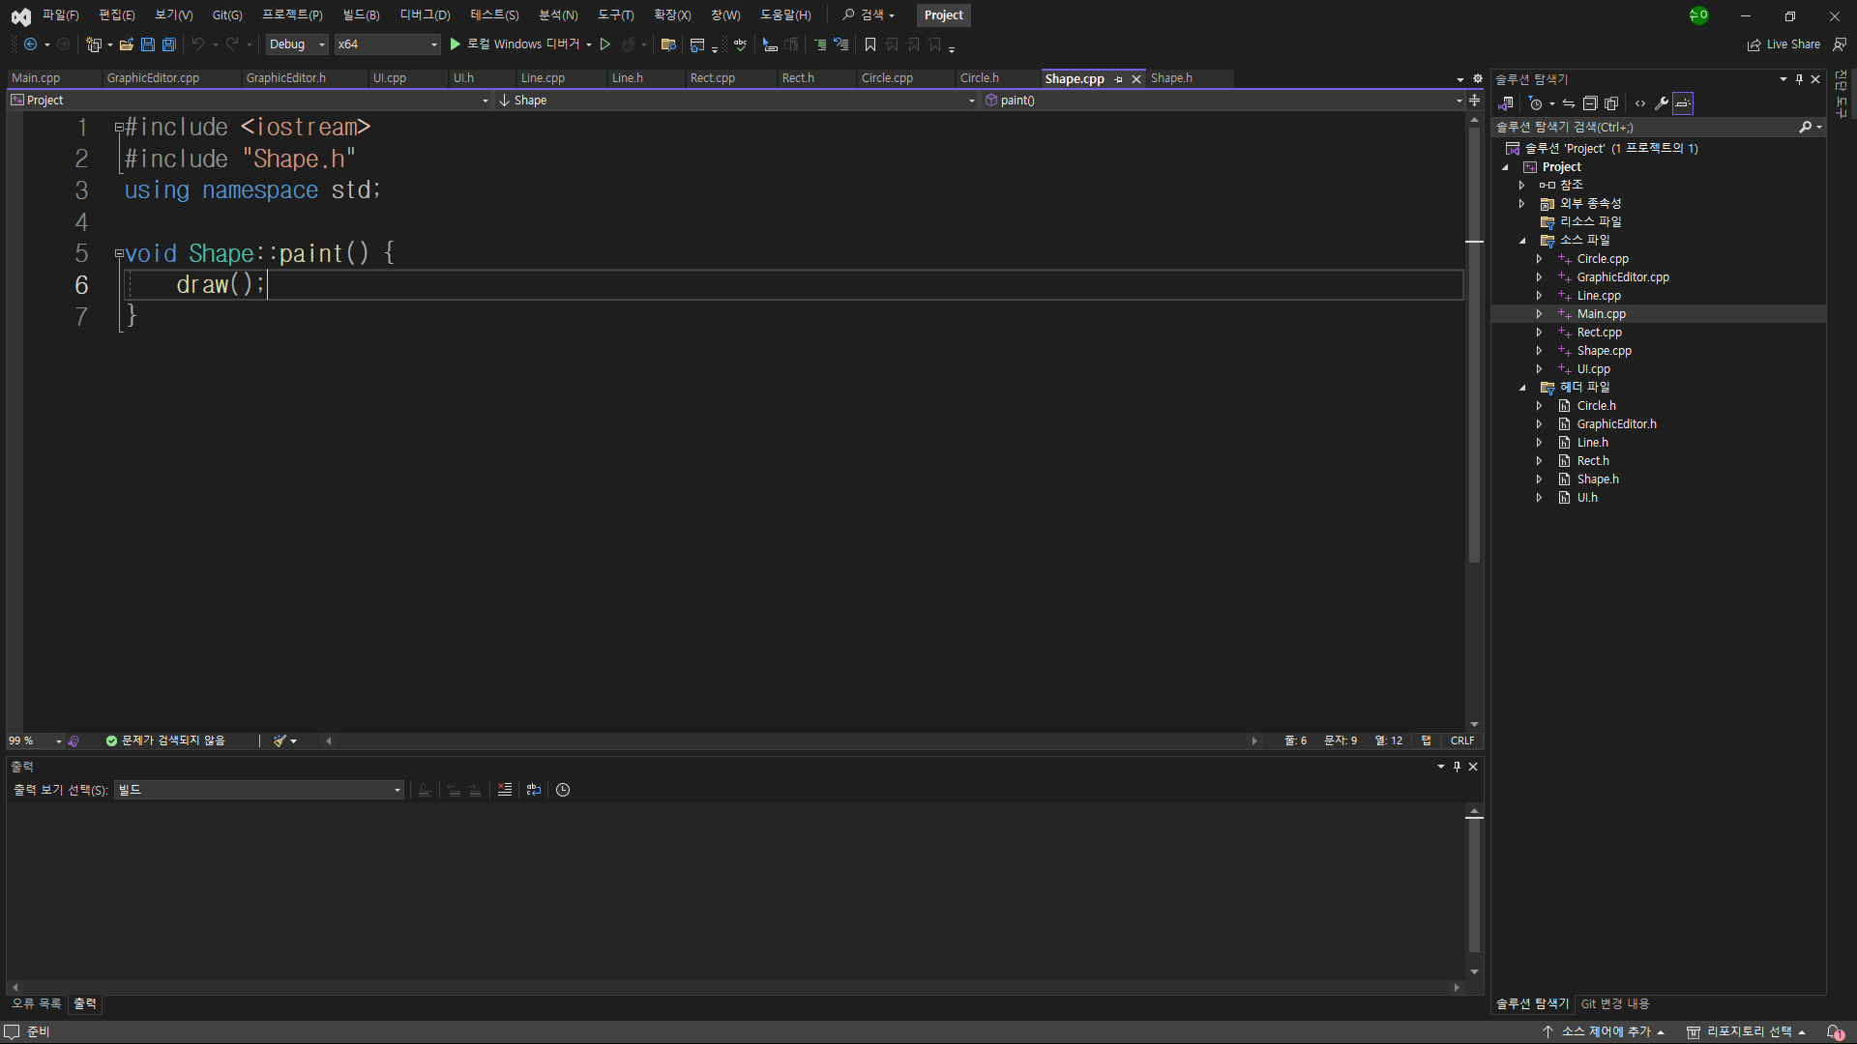
Shape.cpp

Slide 7
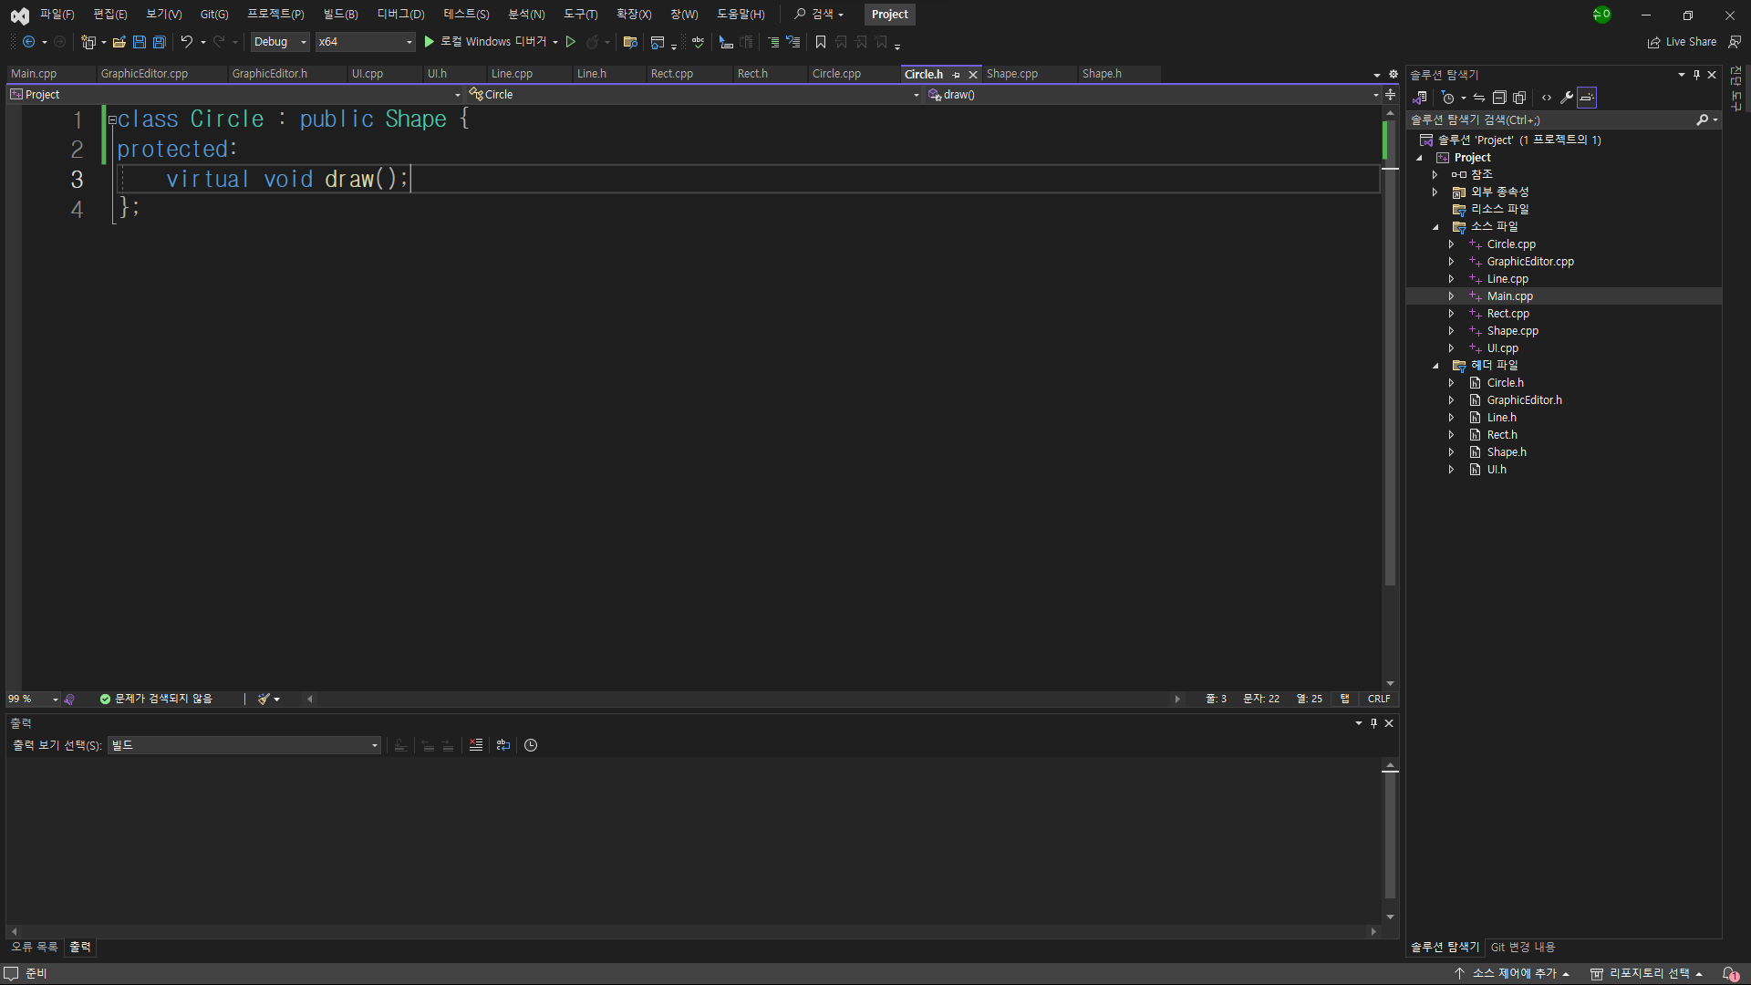
Circle.h

Slide 8
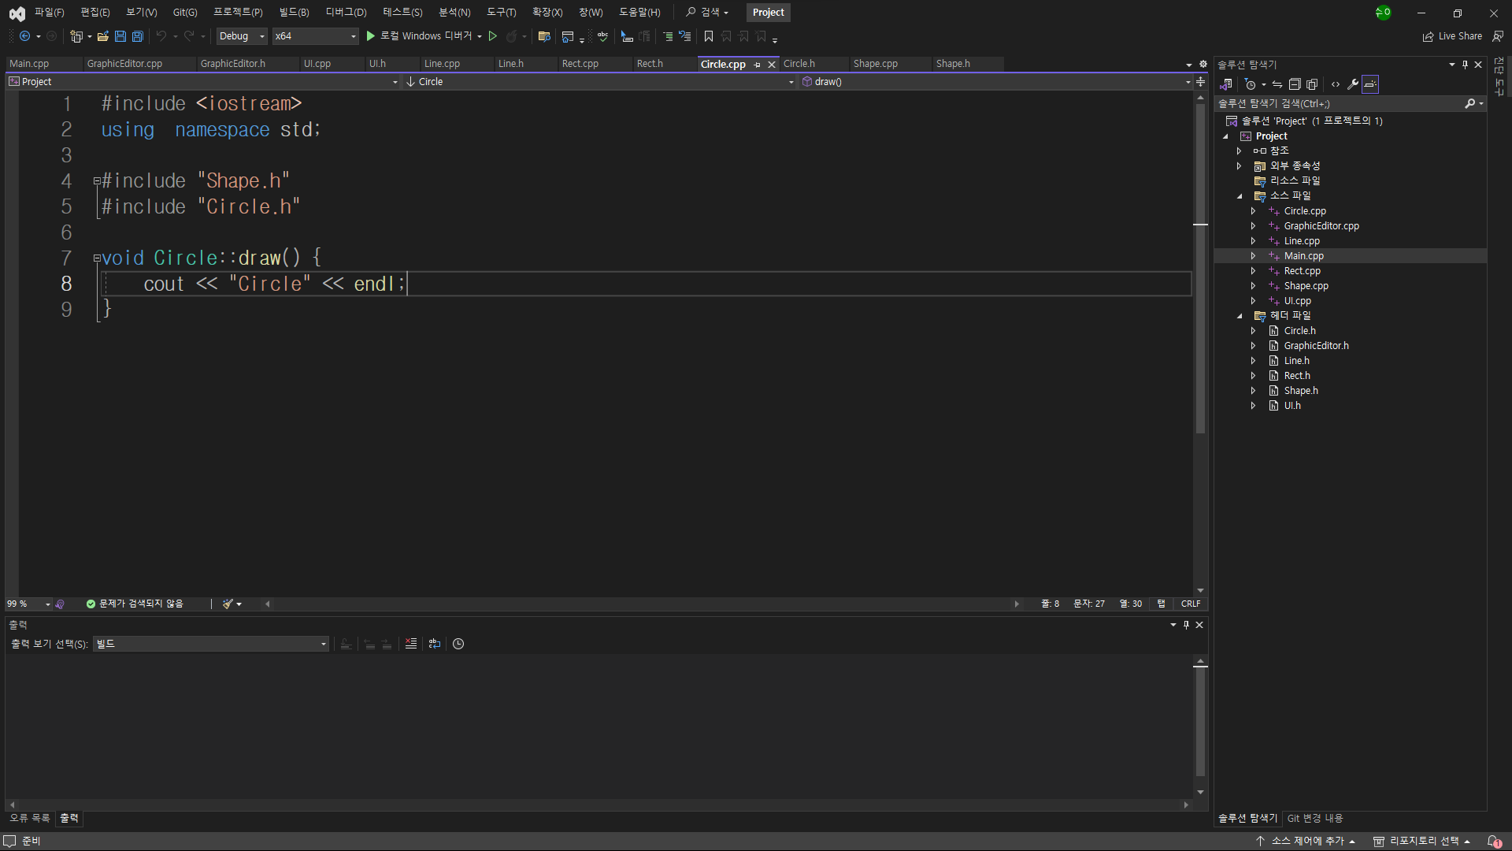
Circle.cpp

Slide 9
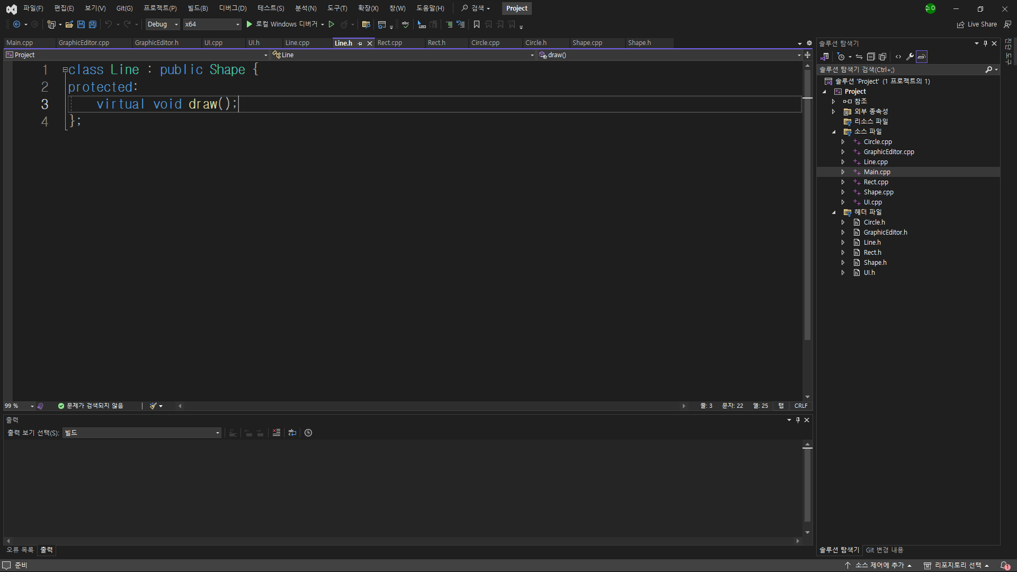
Line.h

Slide 10
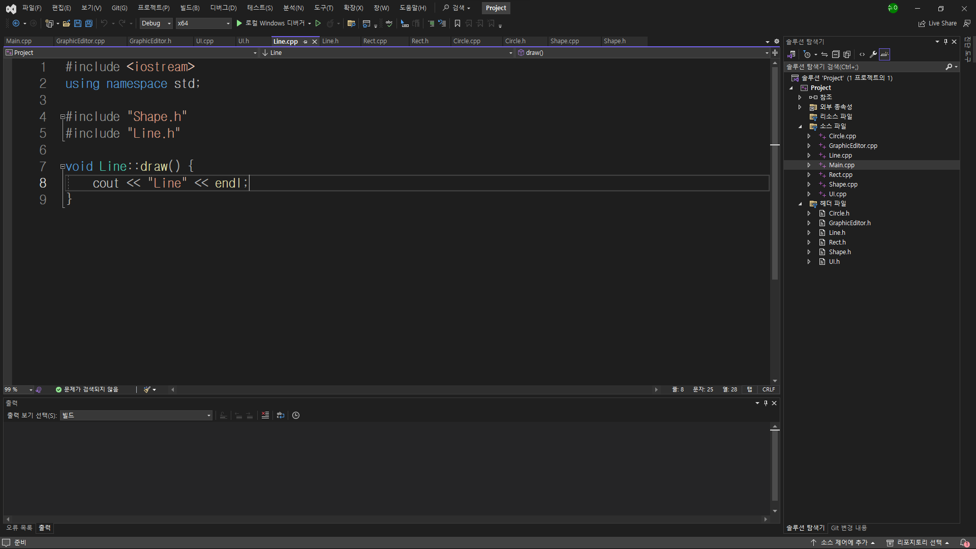
Line.cpp

Slide 11
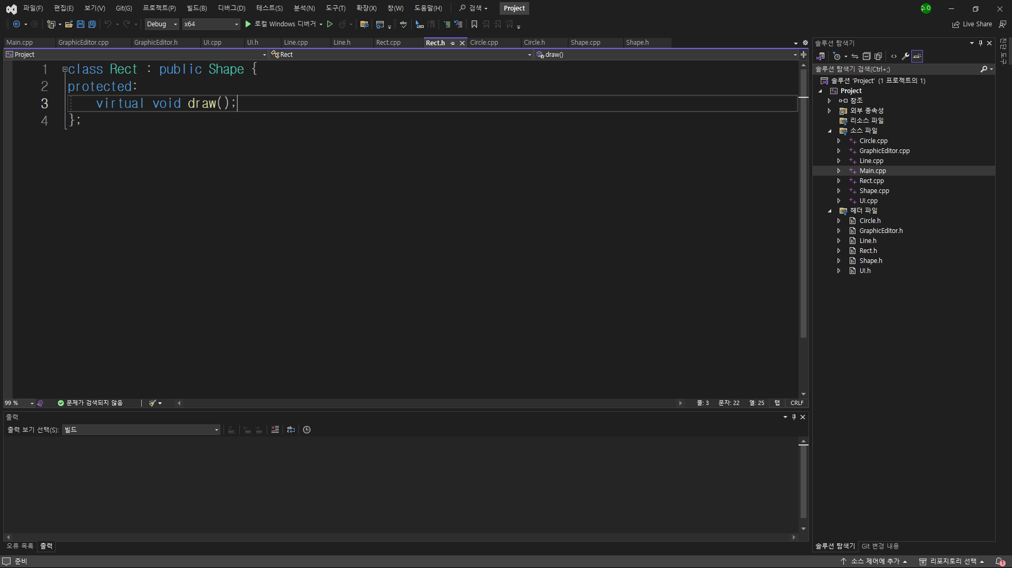
Rect.h

Slide 12
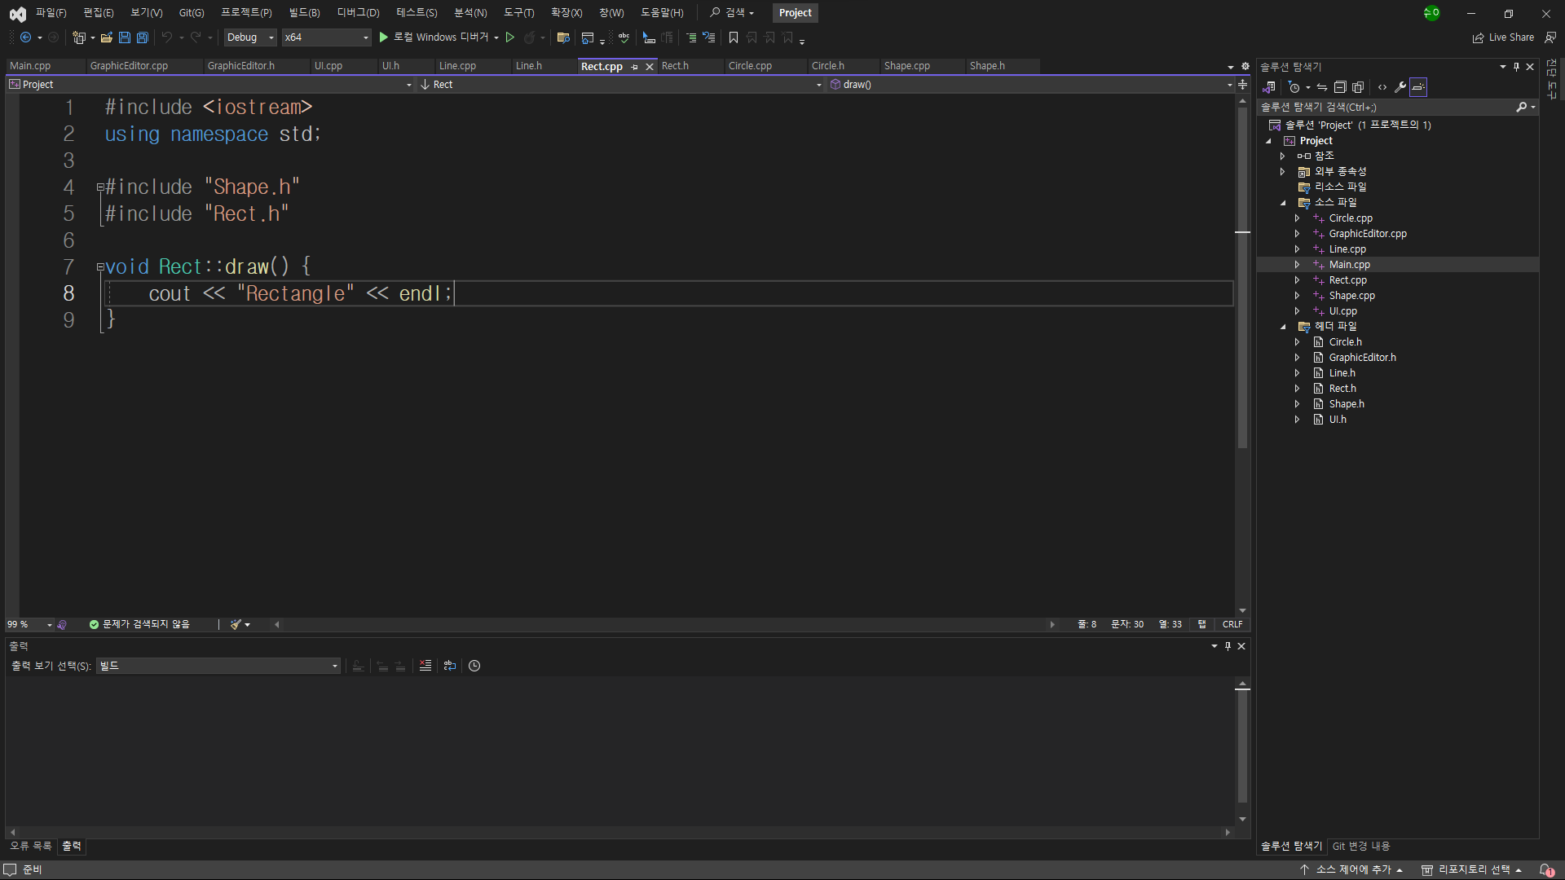
Rect.cpp

Slide 13
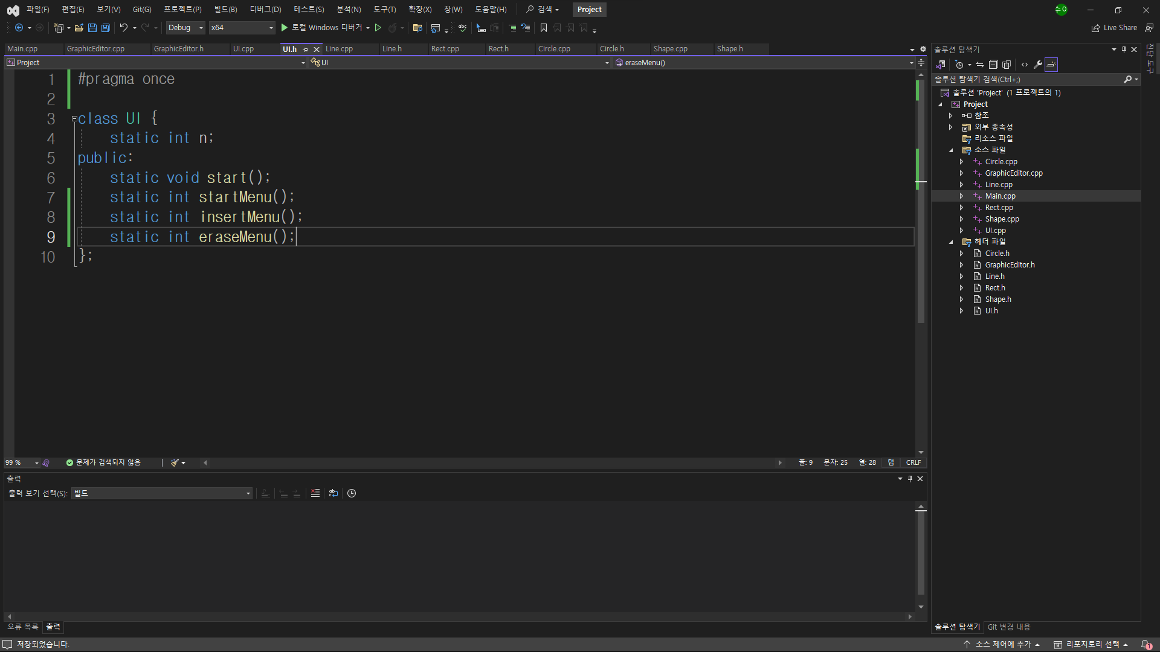
UI.h

Slide 14
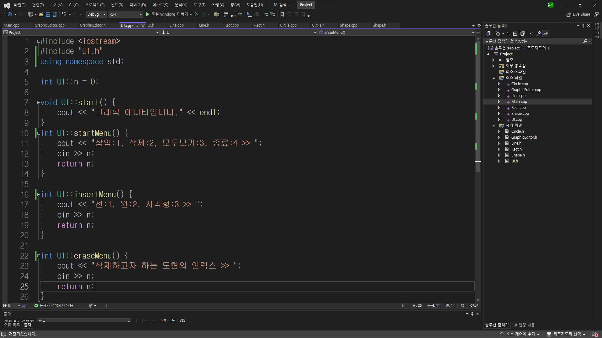
UI.cpp

Slide 15
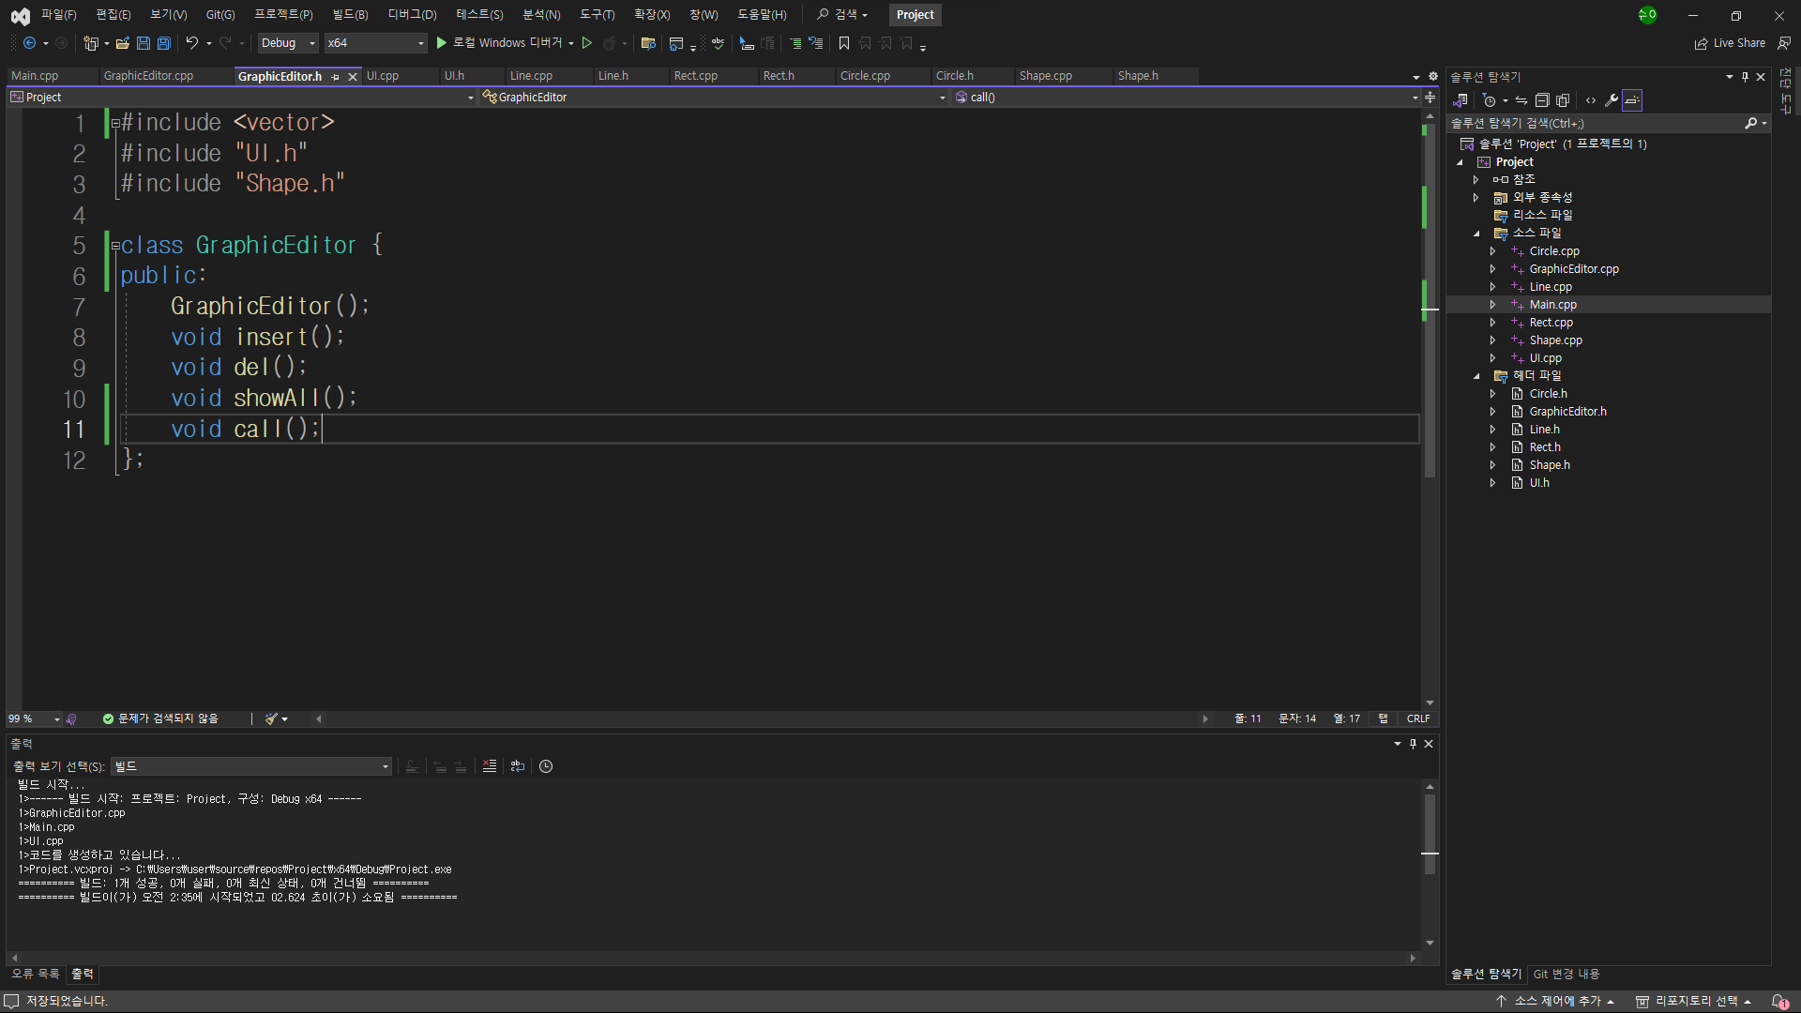
GraphicEditor.h

Slide 16
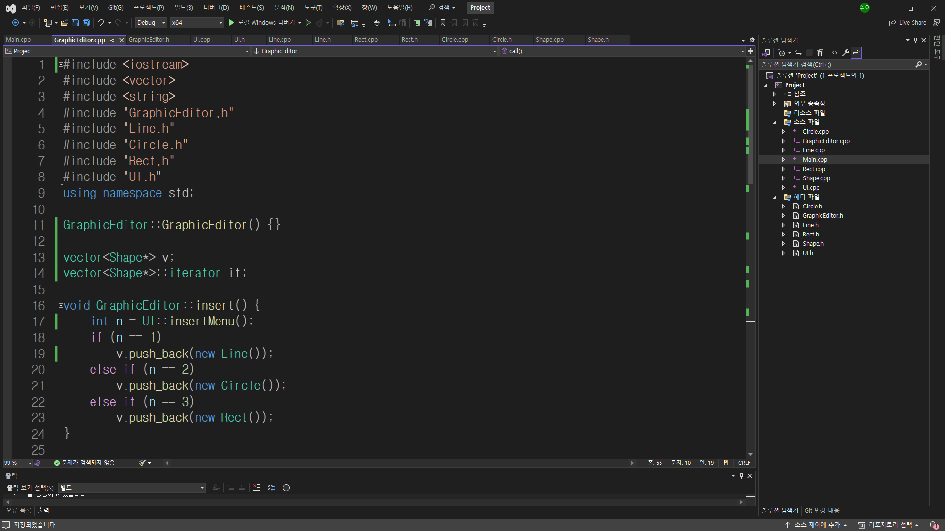
GraphicEditor.cpp(1/3)

Slide 17
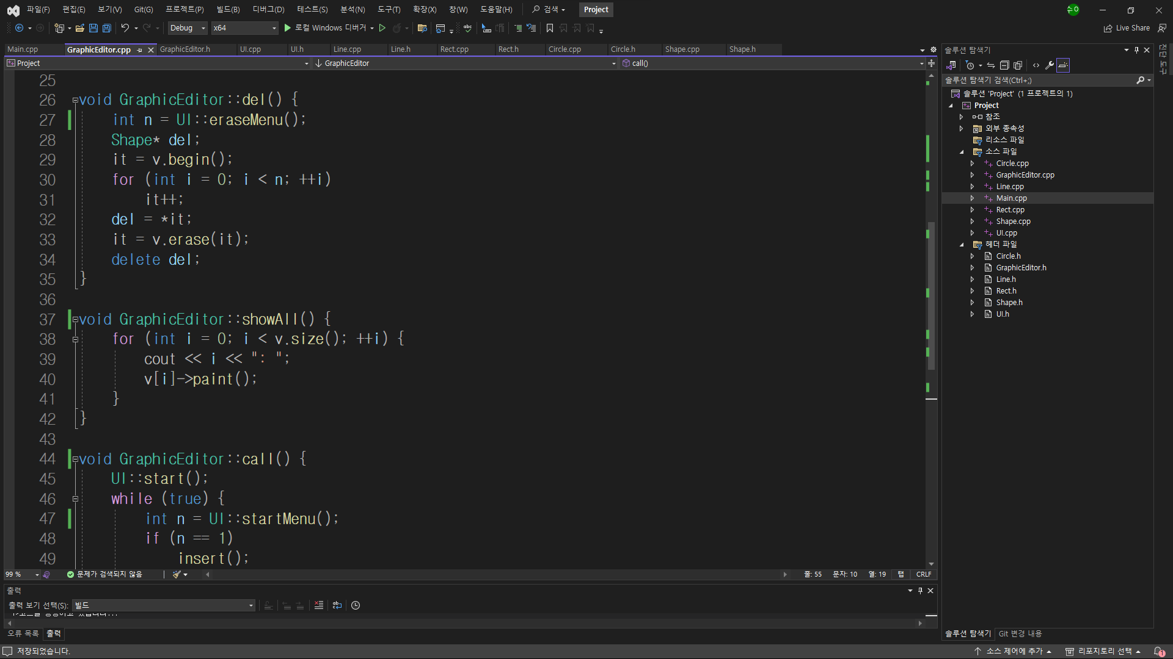
GraphicEditor.cpp(2/3)

Slide 18
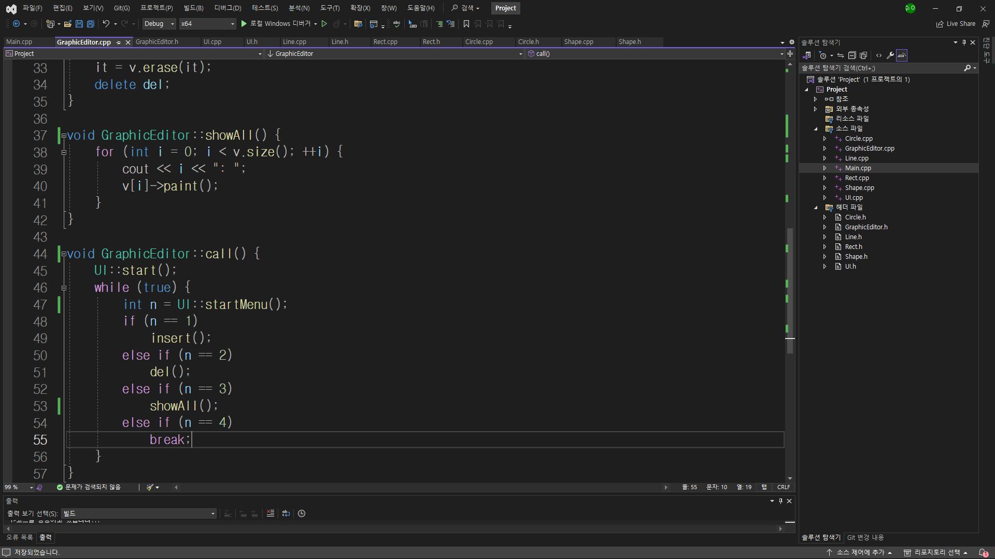
GraphicEditor.cpp(3/3)

